Slide 1

S3LR_Bot
Based on ChatGpt
The bot we will build will harness the power of Openai integration and include a comprehensive todo list feature. This amalgamation of functionalities will allow users to interact with the bot seamlessly while accessing external services and managing their tasks effectively.

Slide 2
S3LR_Bot
Based on ChatGpt
The bot we will build will harness the power of Openai integration and include a comprehensive todo list feature. This amalgamation of functionalities will allow users to interact with the bot seamlessly while accessing external services and managing their tasks effectively.

Slide 3

Problem Statement :
Using various accessories from internet gets a hassle as, we have to go through every different website repeatedly. So we need a Medium to perform all operation in one platform for the user convenience.

Slide 4



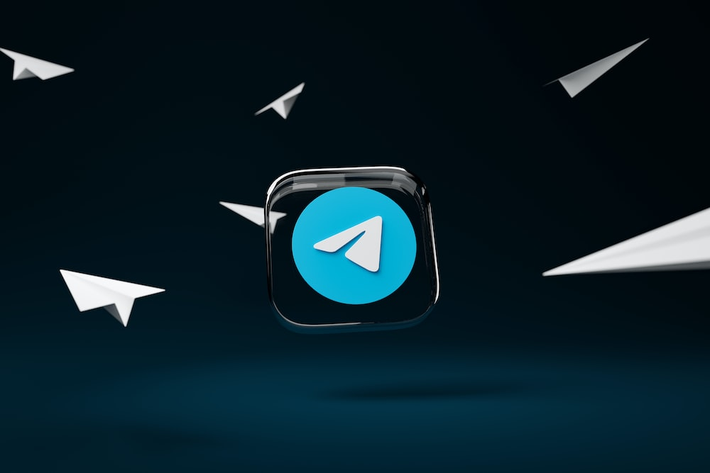




Content

Slide 5






Openai Integration in Chatbots
Todo Integration in Chatbots
Understand how GPT models, such as GPT-3 or GPT-4, have been used to enhance chatbot capabilities in terms of natural language understanding, response generation, and conversational flow. The Bot reviews the user provided text and analyzes it and find the best possible solution for the answer.
For the development of the bot and its integration with the Openai characteristics we use free service as openai which provides us with the particular analyzation for the text input from the user.
For this the required environment get’s provided by the telegram bot and the python code which helps to establish it.
Content

Slide 6
Todo Integration in Chatbots
ChatGPT in Chatbots
Understand how chatbots can help users create, organize, and track their tasks efficiently within the chat interface. Explore studies that discuss features such as task creation, due dates, reminders, priority settings, categorization, and task completion tracking.
/Create command can be used to create a todo which can be viewed later and if done, can also be cleared.
Python programming was used to stored the user entered data into the telegram bot and to perform specific task like /view and /clear.
Content

Slide 7



ChatGPT in Chatbots
ChatGPT in creating conversational AI agents, including Telegram chatbots. Understand the underlying architecture, training methodology, and capabilities of ChatGPT in generating human-like responses. Investigate literature that addresses ethical considerations in deploying ChatGPT-based Telegram chatbots. Explore discussions on responsible AI practices, transparency, bias mitigation, and user privacy to ensure the ethical use of AI in chatbot interactions.
ChatGPT being optimum at its own it becomes conveinent to access it at platforms like telegram where user is mostly interacting
Content

Slide 8


BMI Calculating ChatBot
Discusses different methods and formulas for calculating Body Mass Index (BMI). Understand the standard BMI formula and variations used in different regions or healthcare systems. Evaluate the accuracy and reliability of these methods. Investigate studies that assess the accuracy and validity of BMI calculations compared to other measures of body composition and health indicators. Examine research papers that validate the correlation between BMI and factors such as body fat percentage, waist circumference, and overall health risks. Examine studies that explore the potential benefits of tracking BMI trends over time, setting goals, and receiving personalized feedback within the bot interface.
Content

Slide 9


Telegram ChatBot
The growth of Telegram's bot ecosystem, user demographics, and the reasons behind the increasing popularity of Telegram bots is astounding. Review literature that discusses different frameworks, platforms, and libraries available for developing Telegram bots. Evaluate their features, capabilities, ease of use, and community support to identify the most suitable options for bot development. Examine metrics such as user satisfaction, engagement, task completion rates, and response accuracy to assess the effectiveness and usability of Telegram bots in different scenarios.
Content

Slide 10




SLASH OR COMMAND FUNCTIONS…
Specific Functionality
Youtube Link Download Integration in Chatbots
Read more
implementation of YouTube link download functionality in chatbots. Understand the technical aspects involved in extracting video data, handling different video formats, and providing download options to users. Understand how the bot can identify valid YouTube links and retrieve the corresponding video information for download. Examine studies that discuss different conversion methods, available video resolutions, and techniques for optimizing the download process. Os import helps to download the video in our system. Environment for this function in code.
API
Read more
Content
TO DO LIST
Read more
Youtube Video Downloader
Read more

Slide 11




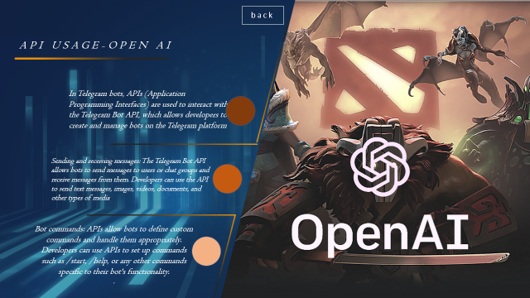

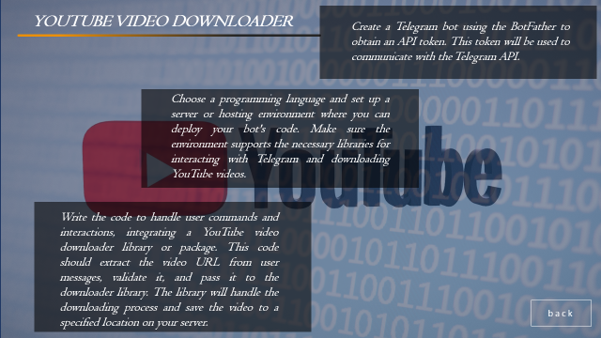
Functionalities

Slide 12
Functionalities

Slide 13


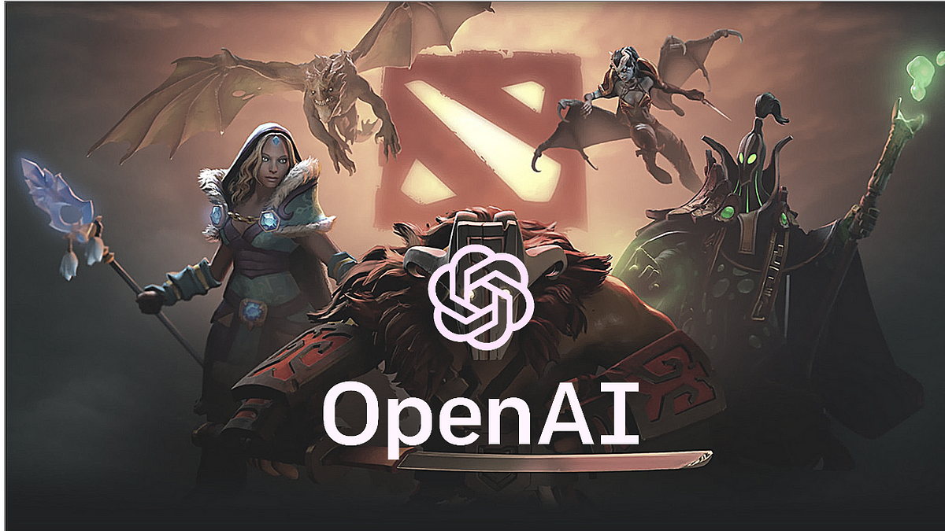
API USAGE-OPEN AI
SLASH FUNCTIONS
In Telegram bots, APIs (Application Programming Interfaces) are used to interact with the Telegram Bot API, which allows developers to create and manage bots on the Telegram platform
1) A command is a simple /keyword that tells the bot what to do.
Highlight commands in messages. When the user taps a highlighted command, that command is immediately sent again.
Sending and receiving messages: The Telegram Bot API allows bots to send messages to users or chat groups and receive messages from them. Developers can use the API to send text messages, images, videos, documents, and other types of media.
Here are some examples:-
/contributors-To get the information of contributors for this Bot.
/JSPM-To know about JSPM college.
/start-To use the Chapgpt.
/Todo – To get into Todo Fuctionality
/video – To Download youtube video from link provided.
Bot commands: APIs allow bots to define custom commands and handle them appropriately. Developers can use APIs to set up commands such as /start, /help, or any other commands specific to their bot's functionality.
.
Here are some more examples:-
Use /bmi – to find the body mass index
Command can be used as /bmii weight(kg) height(m)
back

Slide 14

back
API USAGE-OPEN AI
In Telegram bots, APIs (Application Programming Interfaces) are used to interact with the Telegram Bot API, which allows developers to create and manage bots on the Telegram platform
Sending and receiving messages: The Telegram Bot API allows bots to send messages to users or chat groups and receive messages from them. Developers can use the API to send text messages, images, videos, documents, and other types of media.
Bot commands: APIs allow bots to define custom commands and handle them appropriately. Developers can use APIs to set up commands such as /start,, or any other commands specific to their bot's functionality.
.

Slide 15


YOUTUBE VIDEO DOWNLOADER
Create a Telegram bot using the BotFather to obtain an API token. This token will be used to communicate with the Telegram API.
TO DO LIST
Choose a programming language and set up a server or hosting environment where you can deploy your bot's code. Make sure the environment supports the necessary libraries for interacting with Telegram and downloading YouTube videos.
1
/Todo to start the todo list functionality
2
/create-to create a todo list. And then add your work in the list.
3
Write the code to handle user commands and interactions, integrating a YouTube video downloader library or package. This code should extract the video URL from user messages, validate it, and pass it to the downloader library. The library will handle the downloading process and save the video to a specified location on your server.
/view-to view the todo.
4
/clear-to clear the todo.
back

Slide 16


Result
YOUTUBE VIDEO DOWNLOADER
Create a Telegram bot using the BotFather to obtain an API token. This token will be used to communicate with the Telegram API.
Choose a programming language and set up a server or hosting environment where you can deploy your bot's code. Make sure the environment supports the necessary libraries for interacting with Telegram and downloading YouTube videos.
Write the code to handle user commands and interactions, integrating a YouTube video downloader library or package. This code should extract the video URL from user messages, validate it, and pass it to the downloader library. The library will handle the downloading process and save the video to a specified location on your server.
back
The result of the presentation is a solid foundation for the development of the ChatGPT Telegram Bot, incorporating OpenAI's GPT models, a todo list feature, and the YouTube link download functionality. By leveraging the insights from literature, surveys, and user feedback, the bot can be designed to meet user needs, provide an engaging user experience, and offer valuable functionalities.
The presentation not only showcased the potential of the ChatGPT Telegram Bot but also highlighted the importance of continuous improvement, ethical considerations, and user-centric design in chatbot development. With further development and refinement, the bot has the potential to be a useful and engaging tool for users on the Telegram platform.

Slide 17


CONCLUSION
Result
The result of the presentation is a solid foundation for the development of the ChatGPT Telegram Bot, incorporating OpenAI's GPT models, a todo list feature, and the YouTube link download functionality. By leveraging the insights from literature, surveys, and user feedback, the bot can be designed to meet user needs, provide an engaging user experience, and offer valuable functionalities.
The presentation not only showcased the potential of the ChatGPT Telegram Bot but also highlighted the importance of continuous improvement, ethical considerations, and user-centric design in chatbot development. With further development and refinement, the bot has the potential to be a useful and engaging tool for users on the Telegram platform.

Slide 18




CONCLUSION
CONCLUSION
FIRSTLY.
In conclusion, the development of a telegram bot with API integration and a todo list feature offers numerous benefits and opportunities. .
SECONDLY.
Throughout this presentation we explored the literature,conducted a survey, and reviewed relevant research to understand the landscape of telegram bot development and its potential applications.
THIRDLY.
We discussed the integration of OpenAI’s GPT models, which can enhance the chatbot’s conversional quality and contextual understanding.
LASTLY.
Thank you for your attention and ,I look forward to the successful development and deployment of the ChatGPT Telegram botwith API integration.

Slide 19






Contributors

Slide 20
Contributors

Slide 21


